Slide 1
Dividend Policy
UMET9G-30-1: Accounting and Finance for Decision Making
Dr Adnan Aslam
Lecture 11
Feb 2026

Slide 2
Recap - Capital Structure - Theory & calculations
Explain the concept and components of the Weighted Average Cost of Capital (WACC).
Perform WACC calculations using appropriate market-based data.
Assess the effects of capital structure and financial leverage on firm value and shareholder returns.
Compare key capital structure theories (Trade-Off and Pecking Order) and their practical relevance.

Slide 3

Learning outcomes
By the end of the session, students will be able to:
Classify the different types of dividends: interim, final and stock.
Explain the main dividend theories, including Modigliani & Miller (M&M), relevance vs irrelevance, and tax preference theory.
Evaluate practical issues in dividend policy, such as stability, investor expectations, and signalling effects.
Assess different dividend policies adopted by firms and their potential impact on shareholders.

Slide 4
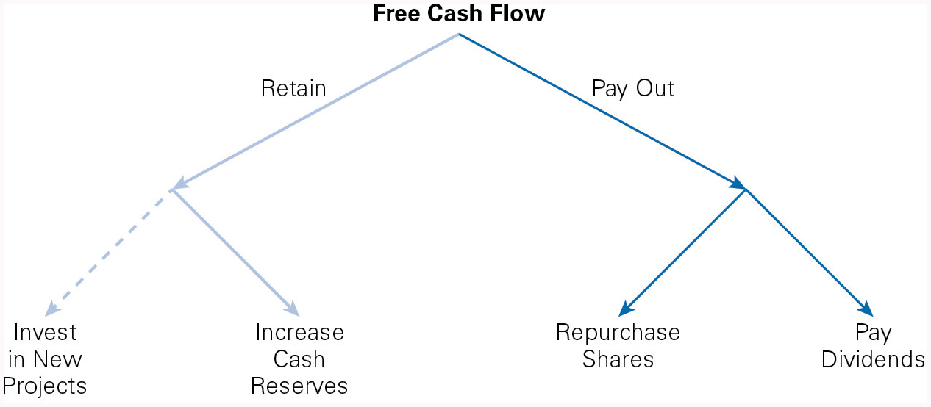
Uses of Free Cash Flow

Slide 5

Dividend
“A payment made out of a firm’s earnings to its owners, in the form of either cash or stock ”
Basic Types of Cash Dividends:
Regular dividends – recurring payments as part of normal profits.
Extra dividends – additional payments above the regular dividend.
Special dividends – one-off payments from exceptional profits.
Liquidating dividends – return of capital when a company is partially or fully winding up.

Slide 6
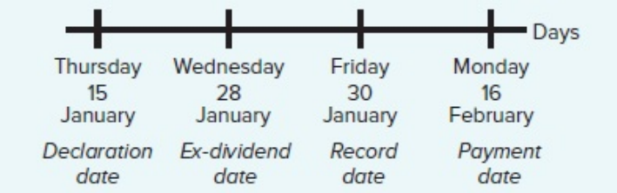
Chronology of a Cash Dividend Payment
Declaration Date – Board approves the dividend (e.g., £1 per share).
Ex-Dividend Date – Usually 2 business days before the record date.
Buy stock before this date → entitled to dividend (“cum dividend”).
Buy stock on/after this date → previous owner gets dividend (“ex-dividend”).
Record Date – Corporation lists shareholders eligible for the dividend.
Payment Date – Dividend is actually paid to shareholders.

Slide 7

Other Dividends types
Stock Dividends
Stock dividends are a non-cash form of dividends.
With a stock dividend (also known as a bonus issue of shares), the company distributes additional shares of its common stock to shareholders instead of cash.
Example: a company announced a 5% stock dividend
Before
If a shareholder owns 100 shares with a purchase price of $10 per share, the total cost basis would be = 100 shares x $10 = $1,000.
After a 5% stock dividend,
The shareholder would own 105 shares of stock at a total cost of $1,000.
= $1000/105 shares = $9.5238 per share

Slide 8

Other Dividends types
SHARE REPURCHASES
The purchase, by a corporation, of its own shares of equity; also known as a buyback.
Methods of Repurchase:
Open Market Purchases – company buys shares like any other investor.
Tender Offer – company offers to buy back a fixed number of shares at a set price (often above market price).
Targeted Repurchase – company buys shares directly from specific shareholders.

Slide 9
Example For Share Repurchase
BP PLC facts:
Equity value = £1,000,000 (100,000 shares, £10 each)
Extra cash available = £300,000
Earnings = £49,000 → EPS = £0.49
Option 1: Pay Dividend
Pays £3 per share dividend (£300,000 ÷ 100,000)
Share price falls to £7 (ex-dividend)
Shareholder with 100 shares:
Value = 100 × £7 = £700
Cash dividend = 100 × £3 = £300
Total wealth = £1,000 (same as before).
Option 2: Repurchase Shares
Buys back 30,000 shares at £10 each
Shares left = 70,000
New EPS = £49,000 ÷ 70,000 = £0.70
Price per share stays £10
Shareholder with 100 shares still has £1,000 value
In a “perfect market” (no taxes, no costs), dividends and repurchases give the same wealth outcome.

Slide 10
Example For Share Repurchase
Real-World Considerations:
Tax Advantage: Dividends taxed immediately; repurchases taxed only if shares sold (often lower capital gains tax).
Signalling & Perceptions: Buybacks may signal confidence in undervalued shares.
Trends:
Buybacks surged in EU (now > half of dividend value).
Declined during crises (e.g., Covid-19), but used by firms like Berkshire Hathaway when share prices were cheap.
(Source: Hillier, 2021, pp: 465)

Slide 11

Does Dividend Policy Matter?
Dividend policy = timing and proportion of earnings paid out as dividends.
Key Questions:
Pay out now or invest and pay later?
Changing dividend patterns does or does not change firm value?
Dividend policy can signal financial health or stability?

Slide 12
Theories on Dividend Payments
The dividend valuation model
The Gordon growth model
Modigliani and Miller’s dividend irrelevancy theory.

Slide 13
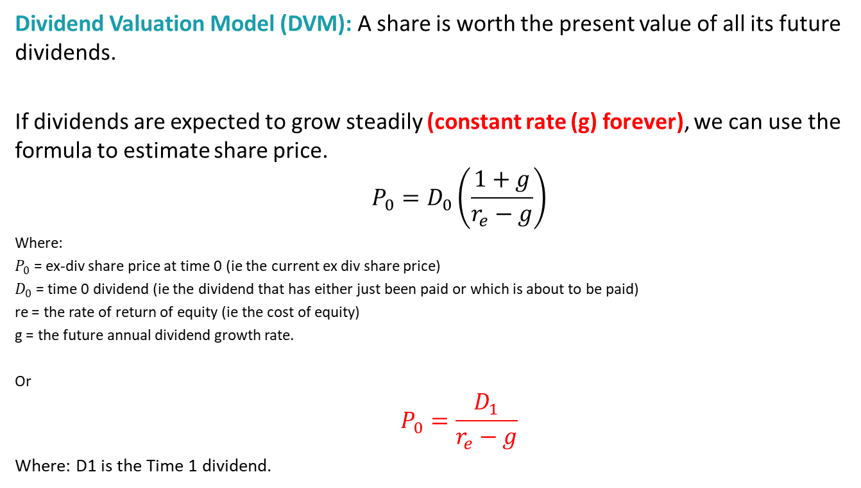
Theories on Dividend Payments
Dividend Valuation Model (DVM): A share is worth the present value of all its future dividends.
If dividends are expected to grow steadily (constant rate (g) forever), we can use the formula to estimate share price.
$$P_{0}=D_{0}\left(\frac{1+g}{r_{e}−g}\right)$$
Where:
$P_{0}$ = ex-div share price at time 0 (ie the current ex div share price)
$D_{0}$ = time 0 dividend (ie the dividend that has either just been paid or which is about to be paid)
re = the rate of return of equity (ie the cost of equity)
g = the future annual dividend growth rate.
Or
$$P_{0}=\frac{D_{1}}{r_{e}−g}$$
Where: D1 is the Time 1 dividend.
Higher expected dividends or growth → higher share price.

Slide 14

Example of DVM
Ford Motors is expected to grow at a constant rate of 6% a year into the indefinite future. It recently paid a dividends of $2.25 a share. The rate of return on stocks similar to Ford is about 11%.
What should a share of Ford Motors sell for today?
$$P_{0}=\frac{D_{1}}{r_{e}\text{− }\text{g}}$$
$$= \frac{\text{\$2.25 }(\text{1.06})}{\text{0}\text{.11 − }\text{0}\text{.06}}$$
$$=\$47.70$$

Slide 15
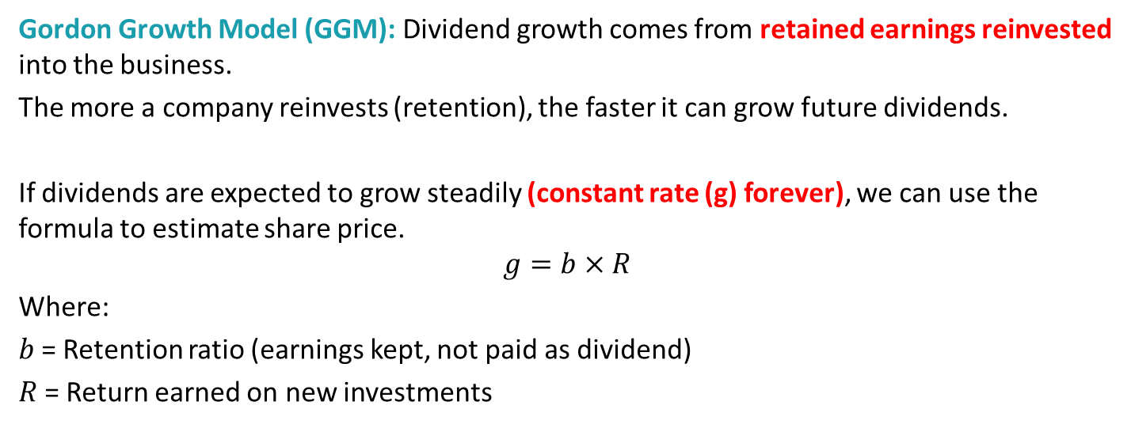
Theories on Dividend Payments
Gordon Growth Model (GGM): Dividend growth comes from retained earnings reinvested into the business.
The more a company reinvests (retention), the faster it can grow future dividends.
If dividends are expected to grow steadily (constant rate (g) forever), we can use the formula to estimate share price.
$$g=b×R$$
Where:
𝑏 = Retention ratio (earnings kept, not paid as dividend)
𝑅 = Return earned on new investments
Higher retention → higher growth in dividends later.

Slide 16
Theories on Dividend Payments
Modigliani & Miller (M&M) Dividend Irrelevance: This theory states that dividend patterns have no effect on share values.
Company value depends on its investment decisions, not how earnings are split between dividends and retained profits.
Cutting dividends today doesn’t destroy value if retained earnings are reinvested well.

Slide 17
Practical Considerations in Dividend Policy
Investor-related factors:
Signalling – Dividend changes send messages (growth vs. trouble).
Trust issues – Shareholders may doubt directors’ optimism.
“Bird in the Hand” preference – Many prefer cash now over uncertain future income.
Clientele effect – Different investors prefer different dividend patterns (e.g., pension funds want stable income).

Slide 18
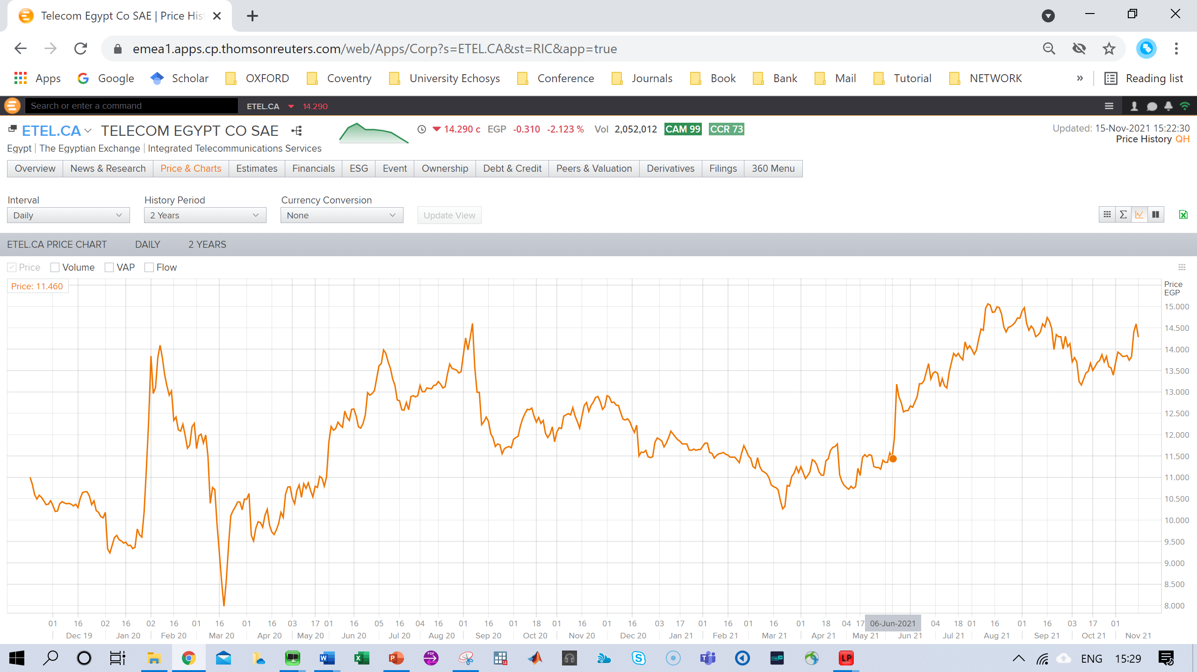
Case study: Dividend announcements
Dividend policy change: the share price jumped from 11.50 to 15.x (BY 30% APPROX.)
Information Asymmetry & The Information Shock

Slide 19
Practical Considerations in Dividend Policy
Company-related constraints:
Liquidity – Firms may cut dividends to preserve cash.
Borrowing covenants – Lenders may restrict dividend payments.
Legal rules – No distributable reserves = no dividends.
Scrip dividends – Shareholders may choose shares instead of cash (Sometimes tax-efficient or avoid transaction costs).
Dividend policy is shaped by both investor expectations and company constraints

Slide 20
Dividend Payment Policies
Policy | Advantages | Disadvantages / Risks
Constant Dividends | Predictable & stable; easy for shareholders to plan income | May frustrate shareholders if earnings rise but dividends stay low
Constant Growth | Steady growth attractive to investors; easier forecasting | Dividend growth may not match earnings growth
Constant Payout Ratio | Transparent link between earnings and dividends; logical approach | Dividend cuts can be misinterpreted as bad news; maintaining dividend in low-earnings periods can signal confidence
Residual Dividends | Focuses on investment opportunities first; maximizes shareholder value | Dividends unpredictable; shareholders may receive little or nothing in low-profit years
No Dividend | All earnings reinvested → supports growth & capital gains; historically successful for high-growth firms (e.g., Microsoft, Apple) | Cannot rely on dividends for income; valuation models like DVM harder to apply

Slide 21
Key Takeaways
Dividends are a way of distributing profits to shareholders (cash, stock, or in some cases through repurchases).
Dividend policies vary: constant dividend, constant growth, constant pay-out ratio, residual dividend, or no dividend.
Dividend models (e.g., Dividend Discount Model, Gordon Growth Model) help value shares based on expected dividend streams.
Ex-dividend date determines who receives the dividend (buy before = entitled; buy after = seller keeps it).
Dividend vs Repurchase: both return value to shareholders, but differ in predictability, signalling, and tax treatment.
Investor perception matters – changes in dividend policy often send signals about management’s view of the company’s future.

Slide 22

Additional Reading
Chapters 16 – Dividends and Payout Policy (Hillier, David. EBook Fundamentals of Corporate Finance 4e, McGraw-Hill UK Higher Ed, 2021.)
Image by Gerd Altmann from Pixabay

Slide 23
Next Week
Financial Risk Management

Slide 24

Any Questions??
If you have questions or find any topic challenging, please feel free to contact me: adnan.aslam@uwe.ac.uk to book an appointment or get clarification.

